Slide 1

School of Computing Science and Engineering
Program: B.Tech
Course Code: BCSE3502
Course Name: Software Engineering & Testing Methodologies

Slide 2
School of Computing Science and Engineering Course Code : BCSE3032 Course Name: SE & TM
Course Outcomes
Program Name: B.Tech

Slide 3
School of Computing Science and Engineering Course Code : BCSE3032 Course Name: SE & TM
CO NUMBER | TITLE
CO1 | Understand the key concerns that are common to all software development processes.
CO2 | Select appropriate process models, approaches and techniques to manage a given software development process.
CO3 | Able to elicit requirements for a software product and translate these into a documented design.
CO4 | Recognize the importance of software reliability and how we can design dependable software, and what measures are used.
CO5 | Understand the principles and techniques underlying the process of inspecting and testing software and making it free of errors and tolerable.
CO6 | Understand the Software Quality Assurance (SQA) architecture and identify Software quality management standards and procedures
Program Name: B.Tech

Slide 4
School of Computing Science and Engineering Course Code : BCSE3032 Course Name: SE & TM
Syllabus
Program Name: B.Tech

Slide 5
School of Computing Science and Engineering Course Code : BCSE3032 Course Name: SE & TM
SOFTWARE & ENGINEERING
Software Engineering = Software & Engineering.
The software is a collection of integrated programs.
Software subsists of carefully-organized instructions and code written by developers on any of various particular computer languages.
Engineering is the application of Scientific and Practical knowledge to invent, design, build, maintain, and improve frameworks, processes, etc.
Program Name: B.Tech

Slide 6
School of Computing Science and Engineering Course Code : BCSE3032 Course Name: SE & TM
UNIT-2
Requirements Engineering Process
Processes used to discover, analyse and validate system requirements
Program Name: B.Tech

Slide 7
School of Computing Science and Engineering Course Code : BCSE3032 Course Name: SE & TM
REQUIREMENTS ENGINEERING PROCESSES
The processes used for RE vary widely depending on the application domain, the people involved and the organisation developing the requirements
However, there are a number of generic activities common to all processes
Requirements elicitation
Requirements analysis
Requirements validation
Requirements management
Program Name: B.Tech

Slide 8
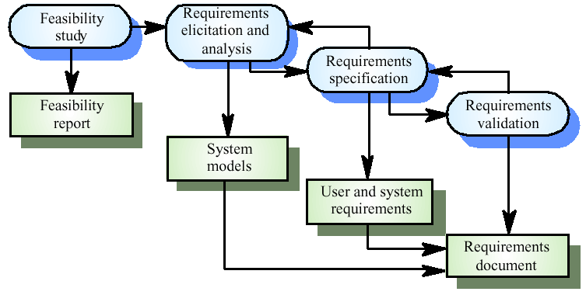
School of Computing Science and Engineering Course Code : BCSE3032 Course Name: SE & TM
THE REQUIREMENTS ENGINEERING PROCESS
Program Name: B.Tech

Slide 9
School of Computing Science and Engineering Course Code : BCSE3032 Course Name: SE & TM
FEASIBILITY STUDIES
A feasibility study decides whether or not the proposed system is worthwhile
A short focused study that checks
If the system contributes to organisational objectives
If the system can be engineered using current technology and within budget
If the system can be integrated with other systems that are used
Program Name: B.Tech

Slide 10
School of Computing Science and Engineering Course Code : BCSE3032 Course Name: SE & TM
FEASIBILITY STUDY IMPLEMENTATION
Based on information assessment (what is required), information collection and report writing
Questions for people in the organisation
What if the system wasn’t implemented?
What are current process problems?
How will the proposed system help?
What will be the integration problems?
Is new technology needed? What skills?
What facilities must be supported by the proposed system?
Program Name: B.Tech

Slide 11
School of Computing Science and Engineering Course Code : BCSE3032 Course Name: SE & TM
ELICITATION AND ANALYSIS
Sometimes called requirements elicitation or requirements discovery
Involves technical staff working with customers to find out about the application domain, the services that the system should provide and the system’s operational constraints
May involve end-users, managers, engineers involved in maintenance, domain experts, trade unions, etc. These are called stakeholders
Program Name: B.Tech

Slide 12
School of Computing Science and Engineering Course Code : BCSE3032 Course Name: SE & TM
PROBLEMS OF REQUIREMENTS ANALYSIS
Stakeholders don’t know what they really want
Stakeholders express requirements in their own terms
Different stakeholders may have conflicting requirements
Organisational and political factors may influence the system requirements
The requirements change during the analysis process. New stakeholders may emerge and the business environment change
Program Name: B.Tech

Slide 13
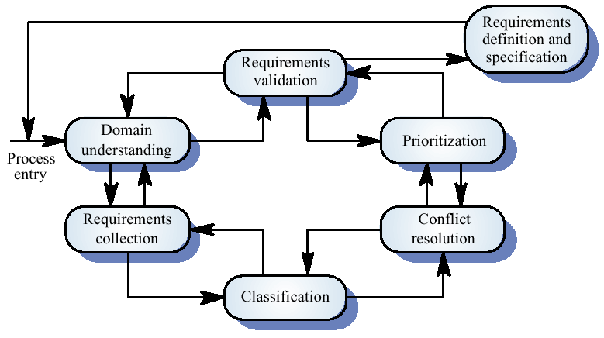
School of Computing Science and Engineering Course Code : BCSE3032 Course Name: SE & TM
THE REQUIREMENTS ANALYSIS PROCESS
Program Name: B.Tech

Slide 14
School of Computing Science and Engineering Course Code : BCSE3032 Course Name: SE & TM
PROCESS ACTIVITIES
Domain understanding
Requirements collection
Classification
Conflict resolution
Prioritisation
Requirements checking
Program Name: B.Tech

Slide 15
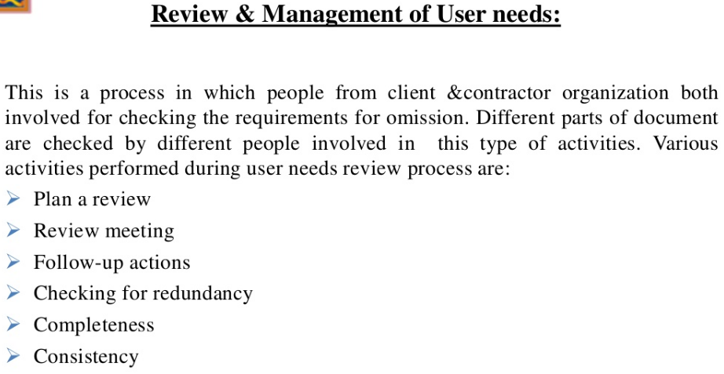
School of Computing Science and Engineering Course Code : BCSE3032 Course Name: SE & TM
Financial Analysis
Program Name: B.Tech

Slide 16
School of Computing Science and Engineering Course Code : BCSE3032 Course Name: SE & TM
FOUR TESTS FOR FEASIBILITY
Operational feasibility
Technical feasibility
Schedule feasibility
Economic feasibility (cost-benefit analysis)
Program Name: B.Tech

Slide 17
School of Computing Science and Engineering Course Code : BCSE3032 Course Name: SE & TM
OPERATIONAL FEASIBILITY
Is the problem worth solving, or will the solution to the problem work?
How well would the candidate solution be received from management, system users, and organization perspective? (political)
Is the solution compliant with laws and regulations? (legal)
Program Name: B.Tech

Slide 18
School of Computing Science and Engineering Course Code : BCSE3032 Course Name: SE & TM
TECHNICAL FEASIBILITY
Is the proposed technology or solution practical?
Do we currently possess the necessary technology?
Do we possess the necessary technical expertise, and is the schedule reasonable?
Program Name: B.Tech

Slide 19
School of Computing Science and Engineering Course Code : BCSE3032 Course Name: SE & TM
SCHEDULE FEASIBILITY
Given our technical expertise, are the project deadlines reasonable?
Program Name: B.Tech

Slide 20
School of Computing Science and Engineering Course Code : BCSE3032 Course Name: SE & TM
ECONOMIC FEASIBILITY
How Much Will the System Cost?
What Benefits Will the System Provide?
Tangible benefits
Intangible benefits
Is the Proposed System Cost-Effective?
Program Name: B.Tech

Slide 21
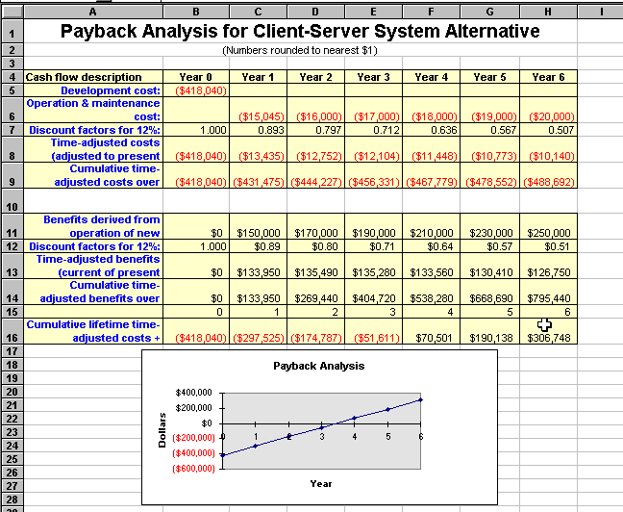
School of Computing Science and Engineering Course Code : BCSE3032 Course Name: SE & TM
Financial Analysis
Program Name: B.Tech

Slide 22
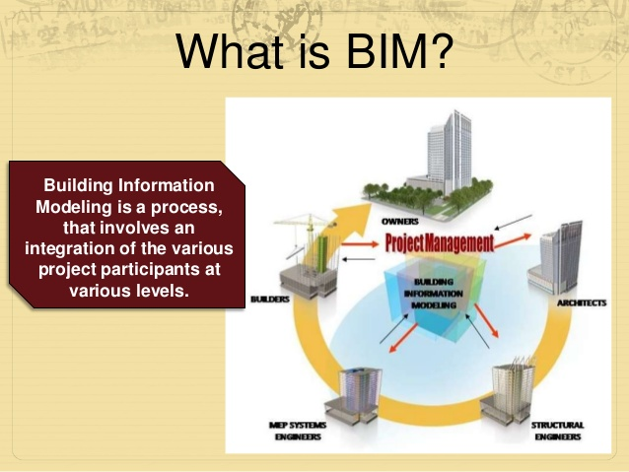
School of Computing Science and Engineering Course Code : BCSE3032 Course Name: SE & TM
SOFTWARE QUALITY ATTRIBUTES
Cost
Schedule
Quality
Program Name: B.Tech

Slide 23
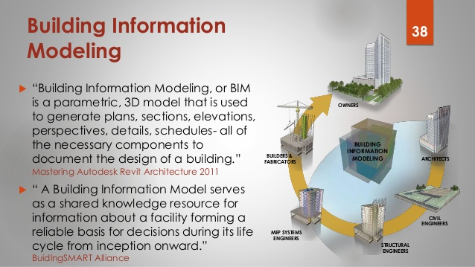
School of Computing Science and Engineering Course Code : BCSE3032 Course Name: SE & TM
Program Name: B.Tech

Slide 24
School of Computing Science and Engineering Course Code : BCSE3032 Course Name: SE & TM
UNIT-2
Software Requirement Specifications (SRS) and Design:
Basic Concept of Software Design, Architectural Design
Program Name: B.Tech

Slide 25
School of Computing Science and Engineering Course Code : BCSE3032 Course Name: SE & TM
BASIC CONCEPT OF SOFTWARE DESIGN
Deriving a solution which satisfies software requirements
Program Name: B.Tech

Slide 26
School of Computing Science and Engineering Course Code : BCSE3032 Course Name: SE & TM
STAGES OF DESIGN
Problem understanding
Look at the problem from different angles to discover the design requirements.
Identify one or more solutions
Evaluate possible solutions and choose the most appropriate depending on the designer's experience and available resources.
Describe solution abstractions
Use graphical, formal, or other descriptive notations to describe the components of the design.
Repeat process for each identified abstraction until the design is expressed in primitive terms.
Program Name: B.Tech

Slide 27
School of Computing Science and Engineering Course Code : BCSE3032 Course Name: SE & TM
THE DESIGN PROCESS
Any design may be modeled as a directed graph made up of entities with attributes which participate in relationships.
The system should be described at several different levels of abstraction.
Design takes place in overlapping stages. It is artificial to separate it into distinct phases but some separation is usually necessary.
Program Name: B.Tech

Slide 28
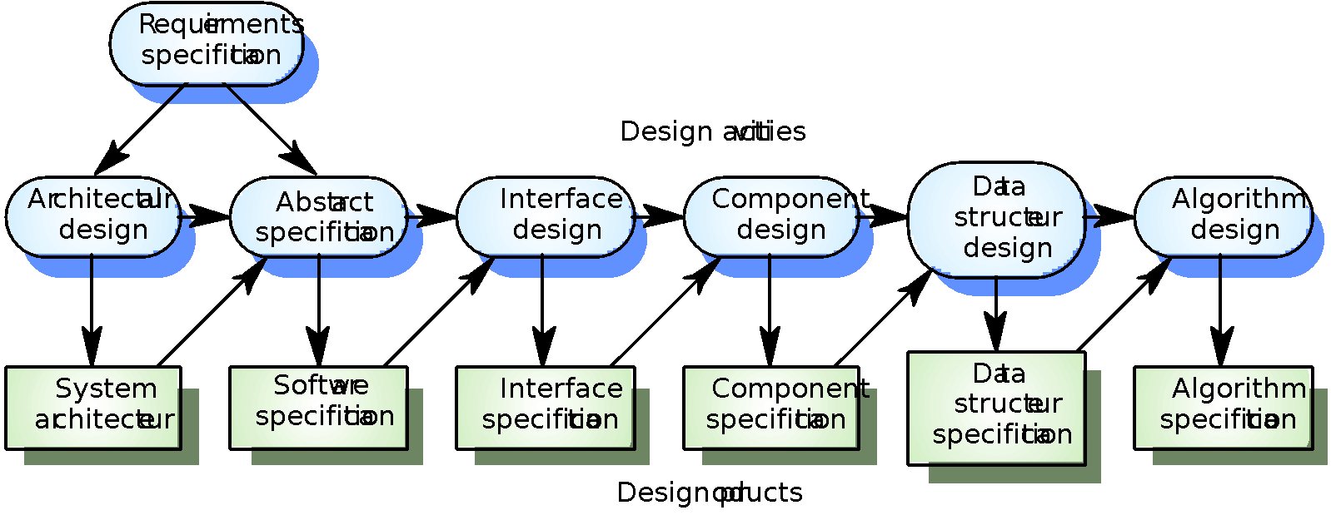
School of Computing Science and Engineering Course Code : BCSE3032 Course Name: SE & TM
THE SOFTWARE DESIGN PROCESS
Program Name: B.Tech

Slide 29
School of Computing Science and Engineering Course Code : BCSE3032 Course Name: SE & TM
Abstraction
Procedural abstraction: natural consequence of stepwise refinement: name of procedure denotes sequence of actions
abstraction
subproblems
time
Program Name: B.Tech

Slide 30
School of Computing Science and Engineering Course Code : BCSE3032 Course Name: SE & TM
DESIGN PHASES
Architectural design: Identify sub-systems.
Abstract specification: Specify sub-systems.
Interface design: Describe sub-system interfaces.
Component design: Decompose sub-systems into components.
Data structure design: Design data structures to hold problem data.
Algorithm design: Design algorithms for problem functions.
Program Name: B.Tech

